Slide 1





Pro-vertos
Sunil Kumar Mehta
Developer

Slide 2


Table Of Contents
01.
Problems
02.
Solutions
03.
About platform
04.
Technologics used

Slide 3
YOUR LOGO
Problem 01
No unique platform for the events and Student organizations

Slide 4
Problem 02
If any organization urgently need some volunteers/Anchor/etc
where they will find them

Slide 5
Problem 03
If any student wants to join any Student organization which one best fit organization

Slide 6
Soution for all the problems
Pro-vertos :
All in one platform

Slide 7

About platform
Event management
It includes event creation / event scheduling in calander.
Profile of Student organizations
Profile of students organizations /path way to their web page.
Vertos / Skilled students
Skilled students like - Anchors,Photographers,video editor etc..
Recrutment drive
Recrutment drive by student organizations for the students .

Slide 8
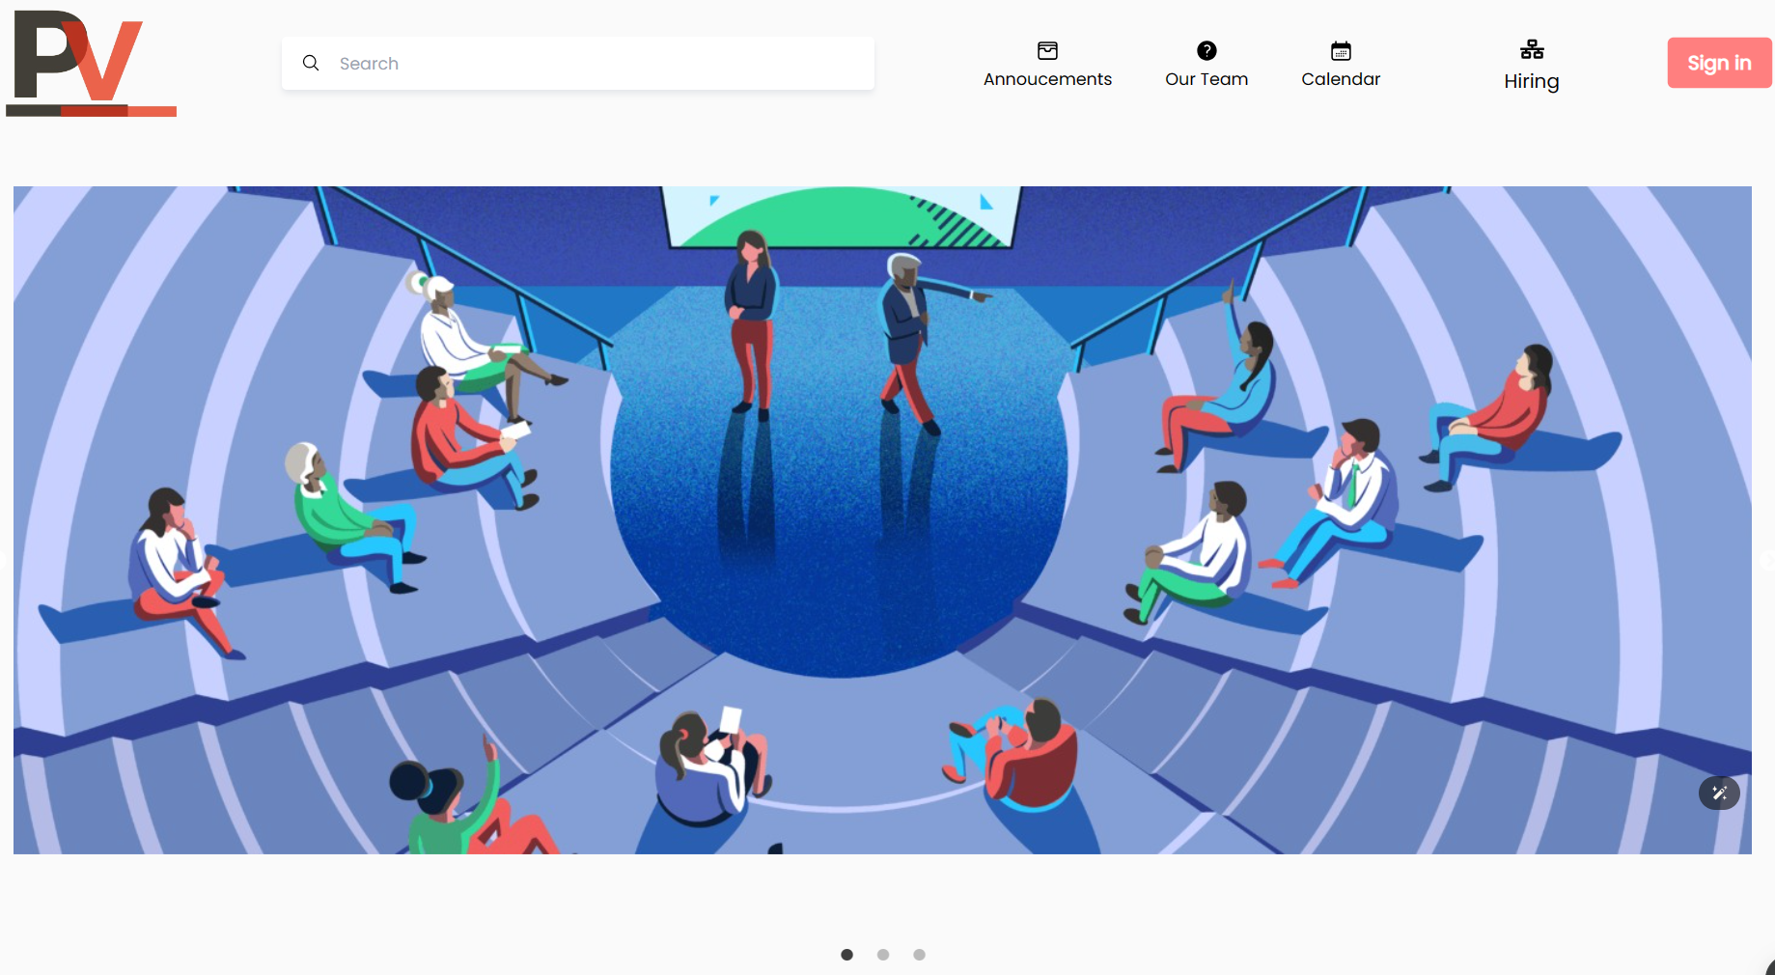
landing page

Slide 9
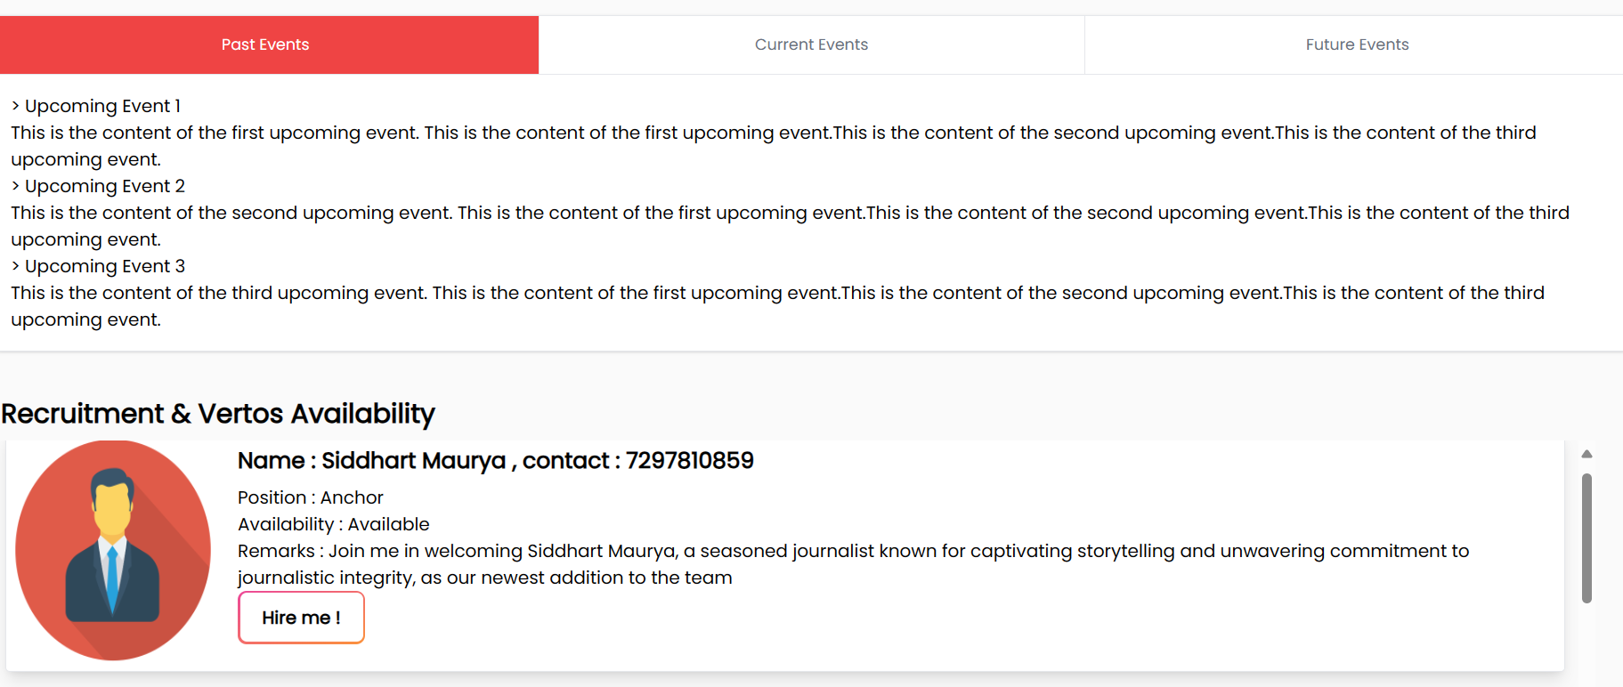
announcement section

Slide 10
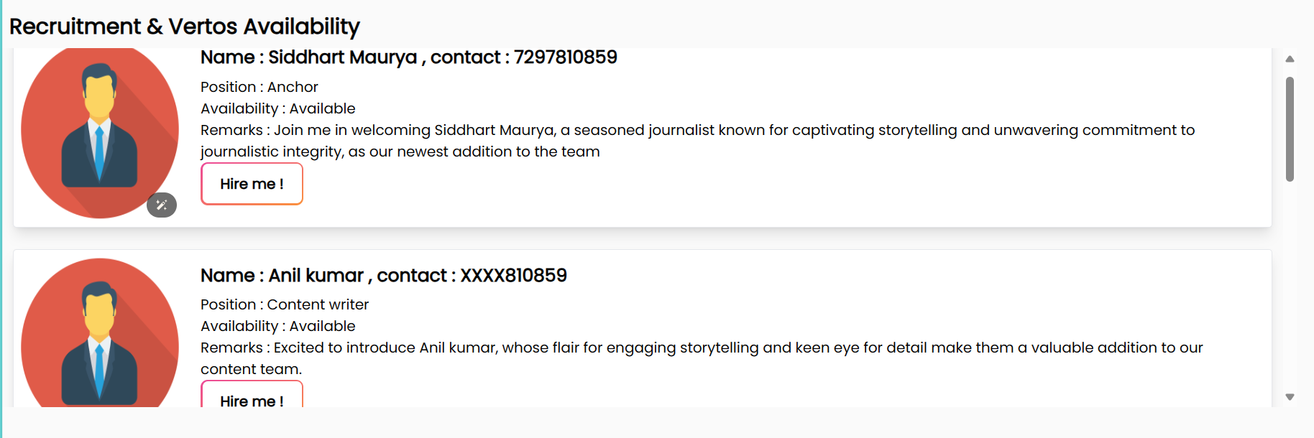
SKILLED STUDENTS AVAILABILITY

Slide 11
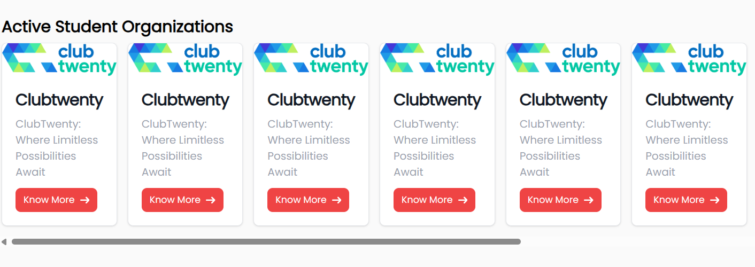
ACTIVE STUDENT ORGANIZATIONS PROFILE

Slide 12
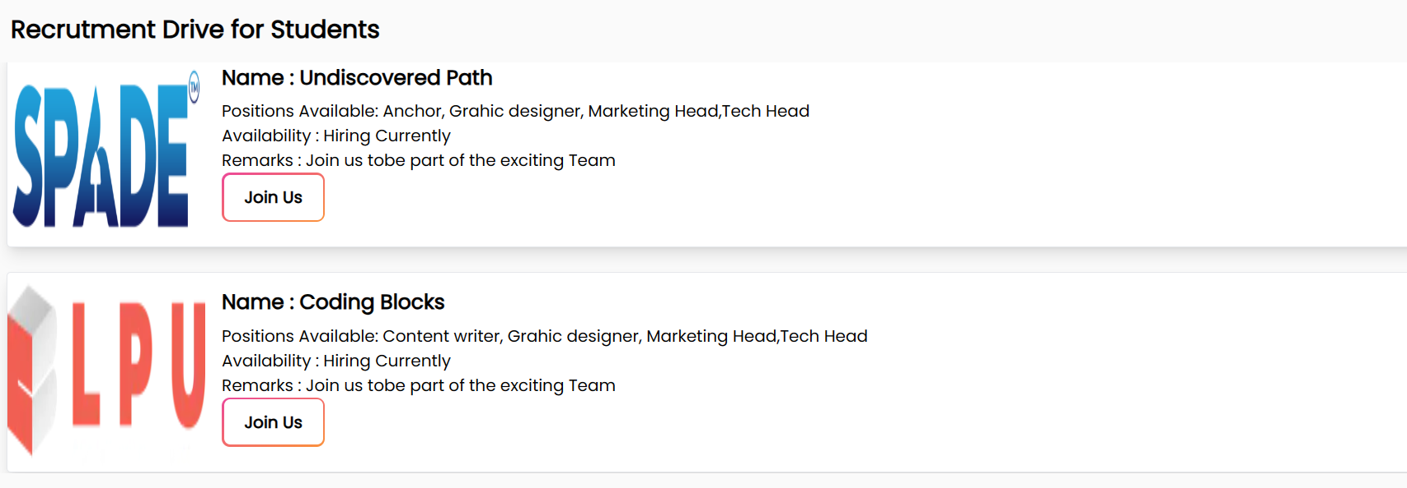
RECURITMENT DRIVE BY STUDENT ORGANIZATION

Slide 13
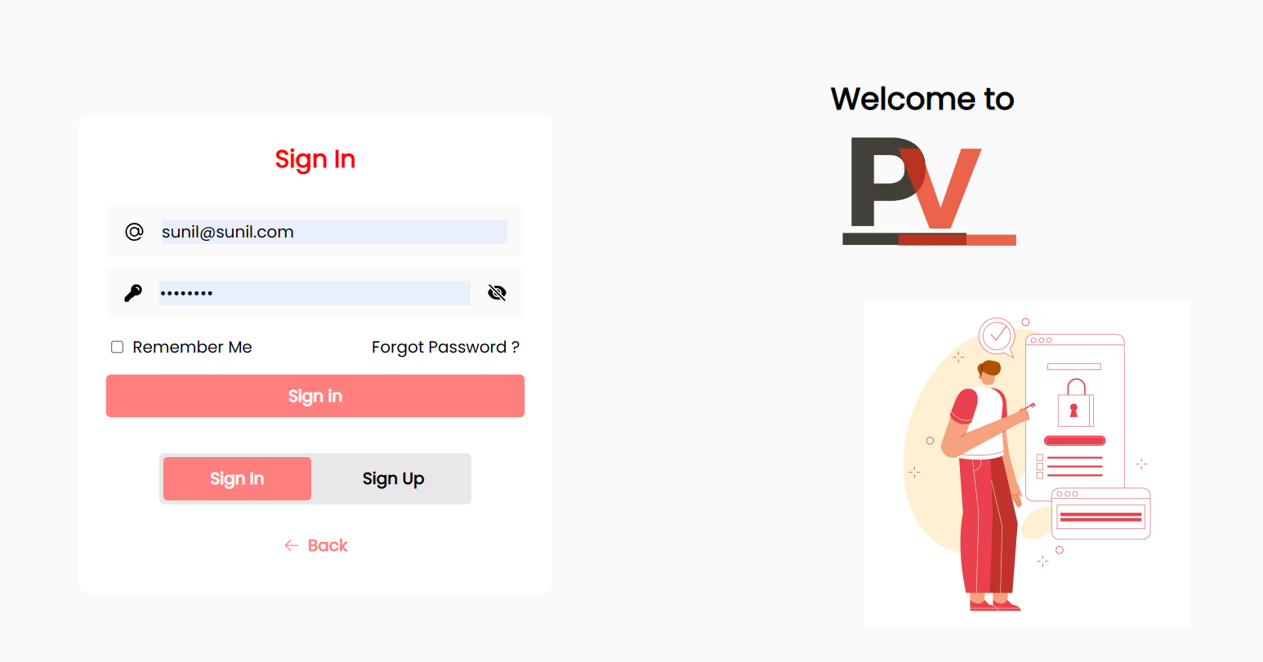
SIGN IN PAGE

Slide 14
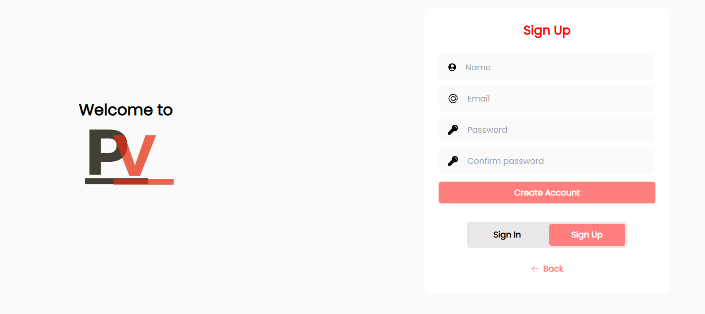
SIGN UP PAGE

Slide 15
Technologics used
React.js
Node.js
Express.js
MongoDB
NPM (Node Package Manager)

Slide 16
Thanks

